Slide 1
ERRORS & EXCEPTIONS IN PYTHON

Slide 2
Errors and exceptions can lead to program failure or unexpected behavior.
Python provides various functions and mechanisms to handle these issues and improve the robustness of the code.
An error is an issue in a program that prevents the program from completing its task.
An exception is a condition that interrupts the normal flow of the execution of a program.
Both errors and exceptions are a type of runtime error, which means they occur during the execution of a program.

Slide 3
Syntax Errors
Syntax errors, also known as parsing errors, are the most common kind of error you get in python.
This error is detected by the interpreter after it detects an anomaly in how your code is written ie: wrong syntax is applied...thus syntax error.
Once you trace the error within your code and rectify it the error will not be detected any more.

Slide 4
Example of a syntax error
Input In [1]
return "Python Is Fun"
^
SyntaxError: 'return' outside function

Slide 5
EXCEPTIONS
In some cases , code can be syntactically correct but when it is executed , an error occurs.
These errors that occur and interrupt the normal execution of your code are known as exceptions.
Python provides a methodology to handle exceptions in what is commonly known as exception handling.
Exception handling in Python is done using try -except blocks within your code.
Exceptions come in different types, and the type is printed as part of the message eg : ZeroDivisionError, NameError and TypeError.

Slide 6
A list of default built-in Python exceptions with descriptions:
AssertionError: raised when the assert statement fails.
EOFError: raised when the input() function meets the end-of-file condition.
AttributeError: raised when the attribute assignment or reference fails.
TabError: raised when the indentations consist of inconsistent tabs or spaces.
ImportError: raised when importing the module fails.
IndexError: occurs when the index of a sequence is out of range
KeyboardInterrupt: raised when the user inputs interrupt keys (Ctrl + C or Delete).
RuntimeError: occurs when an error does not fall into any category.
NameError: raised when a variable is not found in the local or global scope.
MemoryError: raised when programs run out of memory.
ValueError: occurs when the operation or function receives an argument with the right type but the wrong value.
ZeroDivisionError: raised when you divide a value or variable with zero.
SyntaxError: raised by the parser when the Python syntax is wrong.
IndentationError: occurs when there is a wrong indentation.
SystemError: raised when the interpreter detects an internal error.
You can find a complete list of errors and exceptions in Python by reading the documentation.

Slide 7
In normal circumstances, exceptions will stop the code execution and display the error message.
The concept of exception handling allows us to create stable systems, by anticipating these errors and come up with alternative solutions or warning messages.
The most simple way of handling exceptions in Python is by using the try and except block.
  Run the code under the `try` statement.
  When an exception is raised, execute the code under the `except` statement.
Instead of stopping after encountering an exception, our code will move on to an alternative solution we provide after the except statement

Slide 8
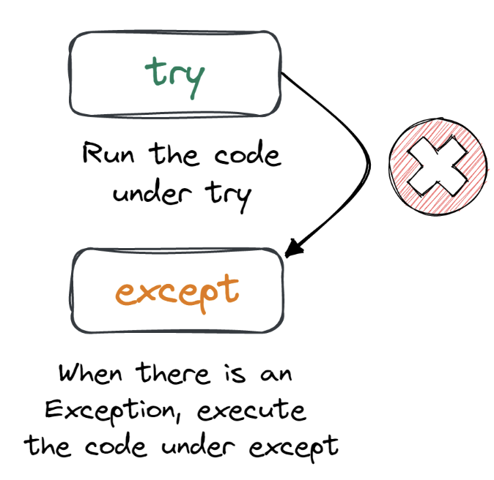

Slide 9
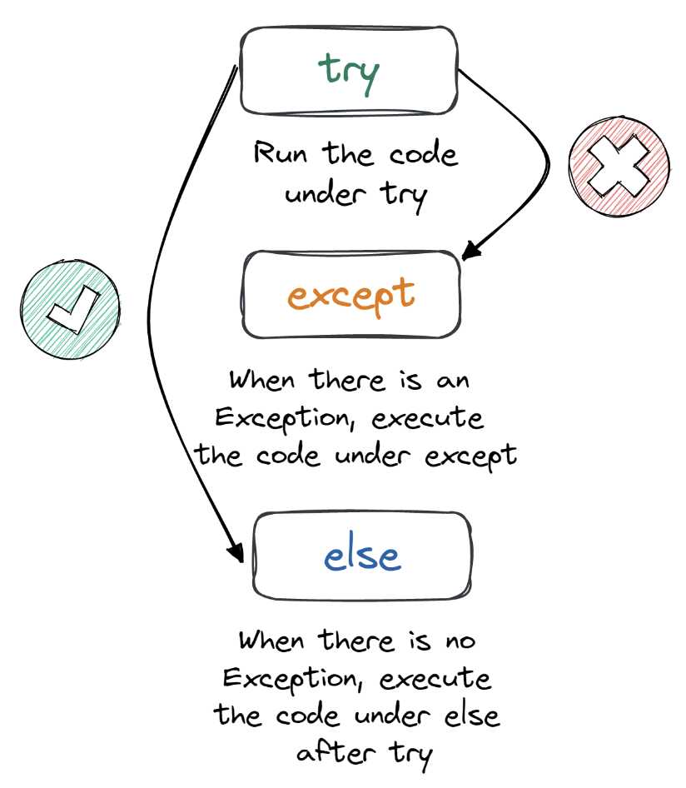

Slide 10
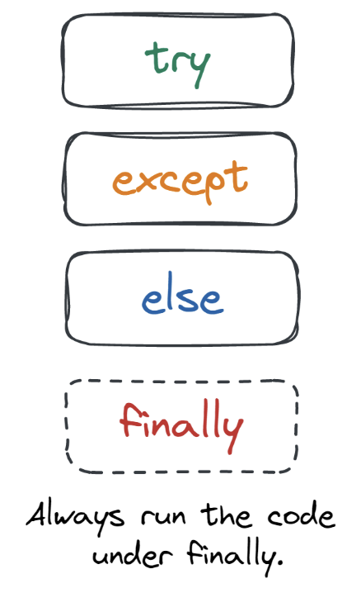

Slide 11
Defining Clean Up Actions in Python
Clean up actions are those statements within a program that are always executed. These statements are executed even if there is an error in the program.
In Python, we use finally keyword to state the part of the code that is going to execute every time the program runs. That is every code line under finally is the clean up action.

